Slide 1

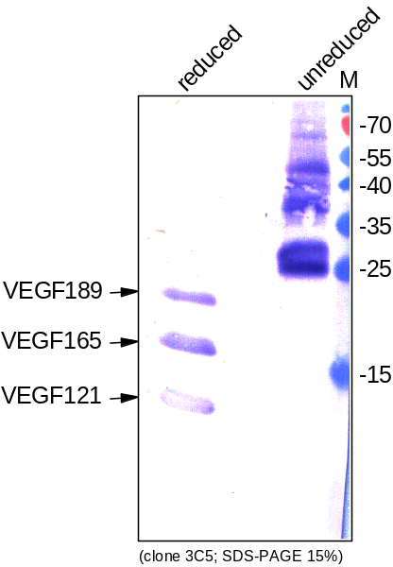
ReliaTech GmbH
Mouse anti-human VEGF-A
(Cat #101-M56)
Figure 1. Western analysis of recombinant human VEGF121 [Cat# 300-072], human VEGF165 [Cat# 300-076] and human VEGF189 [Cat# 300-095] using a monoclonal mouse anti-human VEGF-A antibody [Cat# 101-M56].
http://www.reliatech.de / orders@reliatech.de

